Slide 1
Interactive Systems
2 Building an app
F27IS

Slide 2
Engineering is not the art of building devices; it’s the art of fixing problems. Devices are a means, not an end. Fixing problems means first of all understanding them — and since the whole purpose of the things we do is to fix problems in the outside world, problems involving people, that means that understanding people, and the ways in which they will interact with your system, is fundamental to every step of building a system. …
Essentially, engineering is all about cooperation, collaboration, and empathy for both your colleagues and your customers.
https://medium.com/@yonatanzunger/so-about-this-googlers-manifesto-1e3773ed1788

Slide 3
“I learned that usability is far more important that design - we want people to like using our apps regardless of how good they look!”

Slide 4
“I learned that usability is far more important that design aesthetics - we want people to like using our apps regardless of how good they look!”

Slide 5
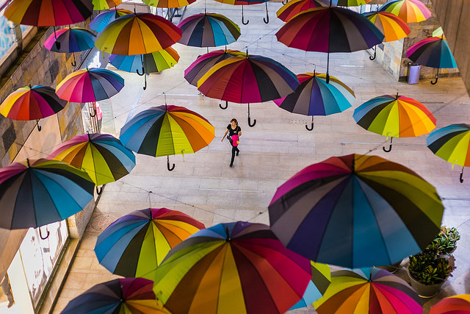
Design is much more than looks!
https://www.flickr.com/photos/95972194@N06/

Slide 6
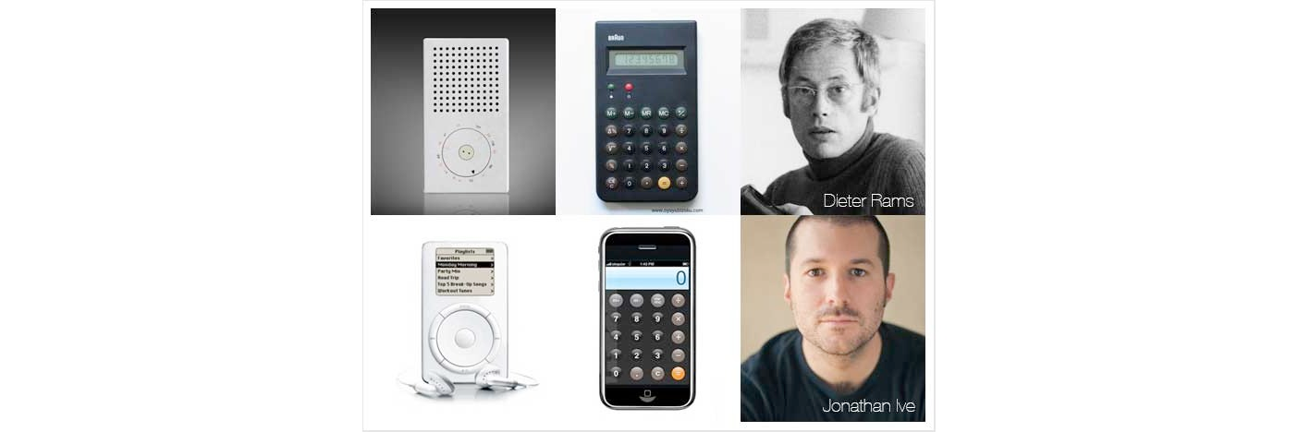
Dieter Rams: industrial designer
https://www.interaction-design.org/literature/article/dieter-rams-10-timeless-commandments-for-good-design

Slide 7
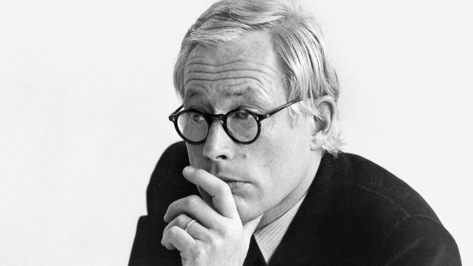
10 commandments for good design
Is innovative
Makes a product useful
Is aesthetic
Makes a product understandable
Is unobtrusive
Is honest
Is long-lasting
Is thorough down to the last detail
Is environmentally friendly
Involves as little design as possible
https://www.vitsoe.com/gb/about/good-design
https://en.wikipedia.org/wiki/Dieter_Rams
Notes:
From late 1970s…

Slide 8
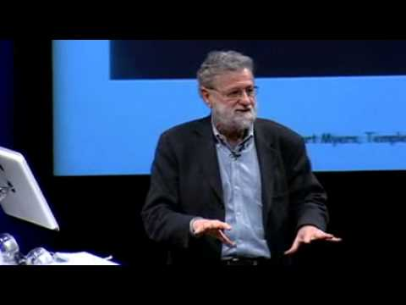
Fun is important to design
Start @ 3m 52s

Slide 9

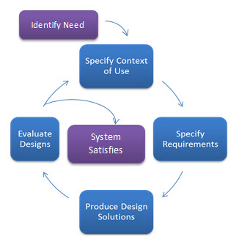
Good design is user centric
https://www.usability.gov/what-and-why/user-centered-design.html
“The rules of thumb state that 10% of your IT staff should be user experience (UX) professionals and 10% of your budget dedicated to UX.”

Slide 10
Today we cover
Procedures
Screens
External non-visible components
Run time errors
Coursework App 1.

Slide 11
Setting the scene
... you will create a game where two images (the "bad" and the "good") are randomly moving on the screen. When the user taps the "bad" guy, the score is increased by one. If the user taps the "good" guy, the score decreases by one. The game ends when the score is negative or the score is 10.

Slide 12
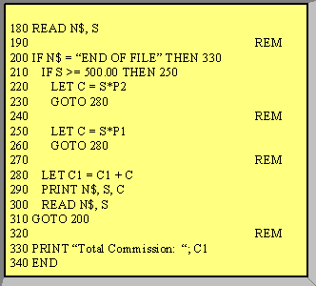
Before procedures...

Slide 13
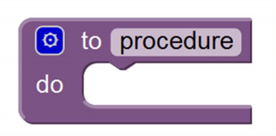
Procedures
Is an independent block
Does a specific task
Isolates internal workings
Eliminates redundancy & enables reuse

Slide 14
Procedures
Is an independent block
Does a specific task
Isolates internal workings
Eliminates redundancy & enables reuse
DRY: don’t repeat yourself

Slide 15
Think about all the ways you can take money out of your bank account…
ATM, Direct Debit, Pay at Till, Standing Order, Transfer…
Do each of these implement their own way to deduct money?

Slide 16
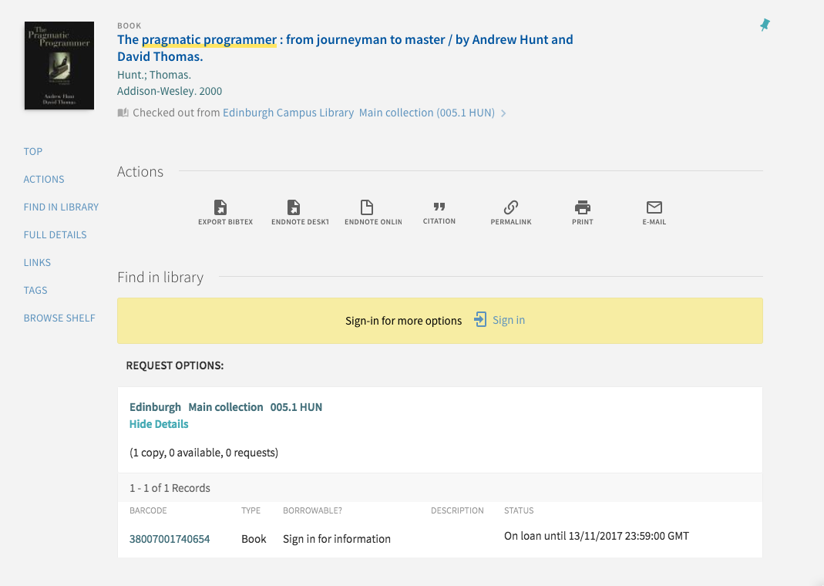
For more pearls of wisdom...

Slide 17
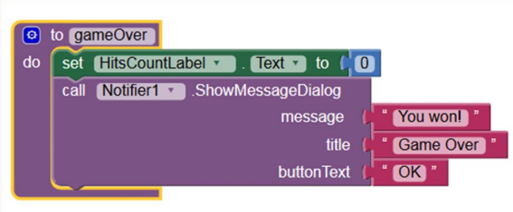
Procedures

Slide 18
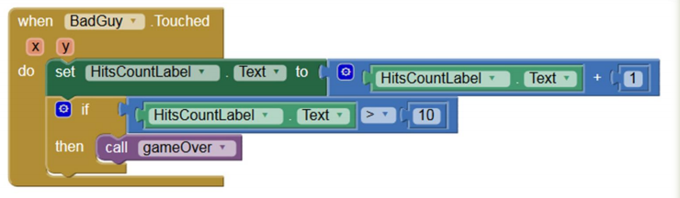
Procedures
Notes:
Create a game where two images (the "bad" and the "good") are randomly moving on the screen. When the user taps the "bad" guy, the score is increased by one. If the user taps the "good" guy, the score decreases by one. The game ends when the score is negative or the score is 10.

Slide 19
Procedures

Slide 20
Procedures

Slide 21
Good or bad implementation?
http://etc.ch/tpjD

Slide 22
Results
https://directpoll.com/r?XDbzPBd3ixYqg8yugNTC76EKEbUwm1P4U3j9KyR0Y

Slide 23
Procedures
Flexibility: what about losing when the GoodGuy is touched?
hmmmm.

Slide 24
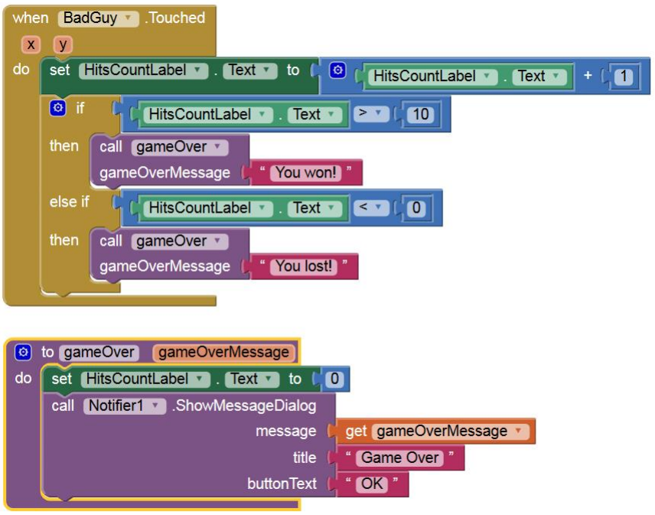
Procedures

Slide 25
Procedures
Passing variable to procedure parameter to increase flexibility & hence reuse

Slide 26
Procedures
Passing argument to procedure parameter to increase flexibility & hence reuse

Slide 27
Procedures
THIS PROGRAM WILL RUN, BUT CAN YOU FIND THE ERROR IN IT?

Slide 28
Today we cover
Procedures
Screens
External non-visible components
Run time errors
Coursework App 1.

Slide 29
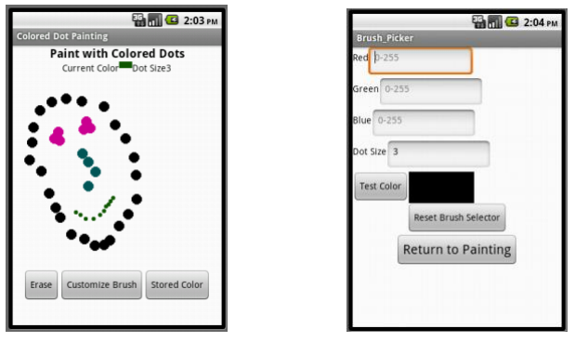
Multiple screens

Slide 30
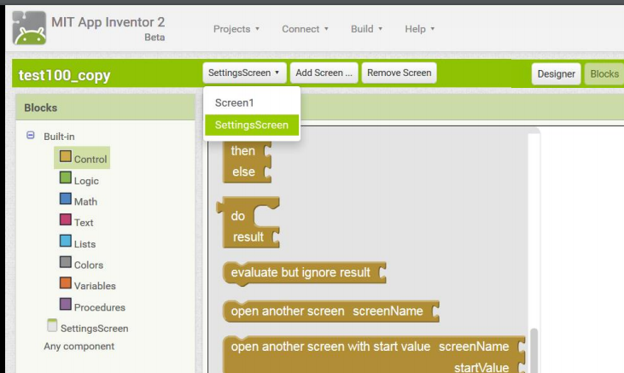
Multiple screens
Notes:
You can create 10 screens… but should you?

Slide 31
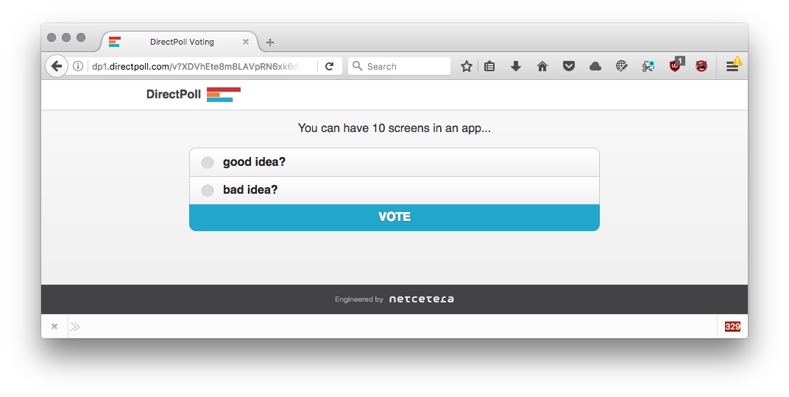
http://etc.ch/JUkR

Slide 32
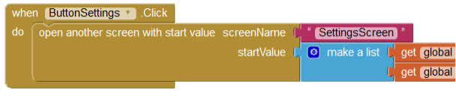
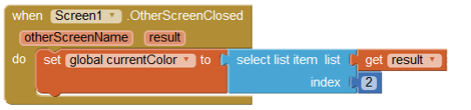
Multiple screens
http://appinventor.mit.edu/explore/ai2/colored-dots.html
http://puravidaapps.com/manager.php

Slide 33
Today we cover
Procedures
Screens
External non-visible components
Run time errors
Coursework App 1.

Slide 34
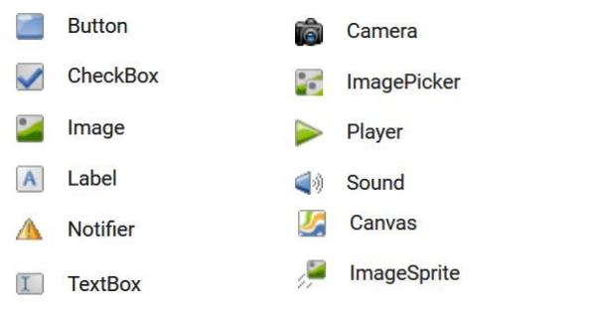
(Internal) Visible components
Essentially User Interface components...

Slide 35
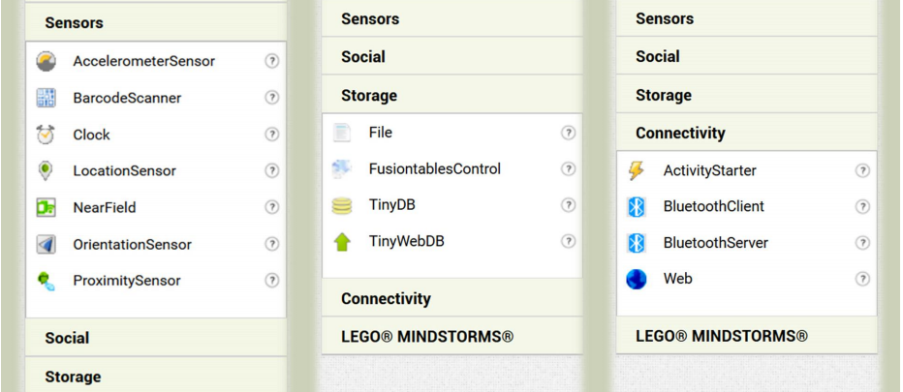
External non-visible components
Not part of the User Interface… components the user may not be aware of

Slide 36
Today we cover
Procedures
Screens
External non-visible components
Run time errors
Coursework App 1.

Slide 37
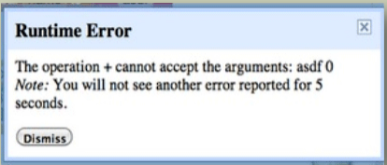
Runtime errors
A runtime error is an error that happens when the app is running. So your App can work but eventually will crash, stop or work erratically.

Slide 38
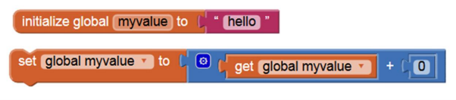
Runtime errors
‘hello’ + 0 = error!
In other languages ‘hello’ + 0 = ‘hello0’
The operation plus cannot accept the argument ‘hello’.

Slide 39
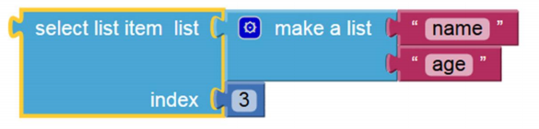
Runtime errors
Attempting to get list item number 3 from a list of 2.

Slide 40
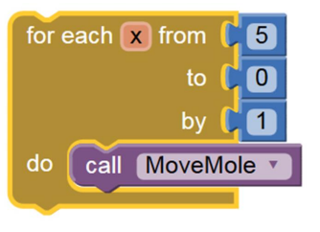
Runtime errors
No alert
box!
For each with a positive increment and end condition less than the start condition.
This will run and run and ...
https://en.wikipedia.org/wiki/Infinite_loop

Slide 41
Today we cover
Procedures
Screens
External non-visible components
Run time errors
Coursework App 1

Slide 42
Coursework app
Your task is to develop an app of your choice
It should be useful or entertaining (or both)
Simple app with visible components (CW1)
Extended app with non-visible components (CW2)

Slide 43
Minimal Viable Product
“A minimum viable product (MVP) is a product with just enough features to satisfy early customers, and to provide feedback for future product development.”
CW1 is a MVP

Slide 44
Marks
CW1 = 35% CW2 = 35%
DRAFT rubric CW1:
Usability: 15
Aesthetics: 5
Concept: 5
Functionality & code: 5
Ambition: 5
This may change!

Slide 45
Suitable components for app 1 & 2
The first coursework app should be built mainly with components that use capabilities internal to the device to interact with the user
The second coursework app will include components for more sophisticated interaction with the outside world
We have listed which components fall within each category at https://goo.gl/YqQg7x

Slide 46
Coursework app 1
Use procedures sensibly
Use screens
Use appropriate components:
https://goo.gl/YqQg7x
Create a lot of interactivity with the user
Should be extensible to include interactivity with other systems or people (for coursework app 2)

Slide 47
First assessment
You will need to present your app idea in lab 3!

Slide 48
In Lab 3...
You present 3-5 slides about your idea covering what, why and how
Feedback from other students on
Your presentation of the idea
Is the idea for the app clear and well-defined?
What are the planned App Inventor components?
Would the app be useful / entertaining?
Is it achievable in 3 weeks?
Learning log should reflect upon the feedback

Slide 49
Coursework app 1: submission
Everyone will submit on Friday 13th October an aia file AND an apk file
http://appinventor.mit.edu/explore/ai2/share.html
Everyone will demo their app during the week 6 labs (details to follow).

Slide 50
Coursework app 2
For part two of the course you will be asked to extend this app
Make sure your app is potentially extensible
Reflect on issues and potential
Provision will be made for students whose first app is unsuccessful

Slide 51
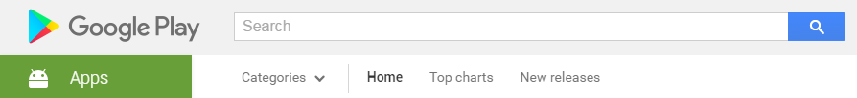
Coursework app 1
For inspiration:
http://play.google.com

Slide 52

Coursework app 1
For inspiration:
http://appinventor.mit.edu/explore/app-month-gallery.html

Slide 53
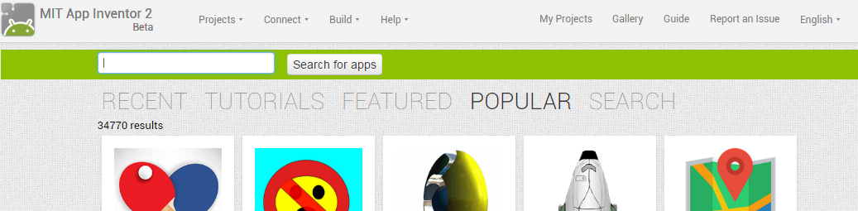
Coursework app 1
For inspiration:
http://ai2.appinventor.mit.edu/

Slide 54
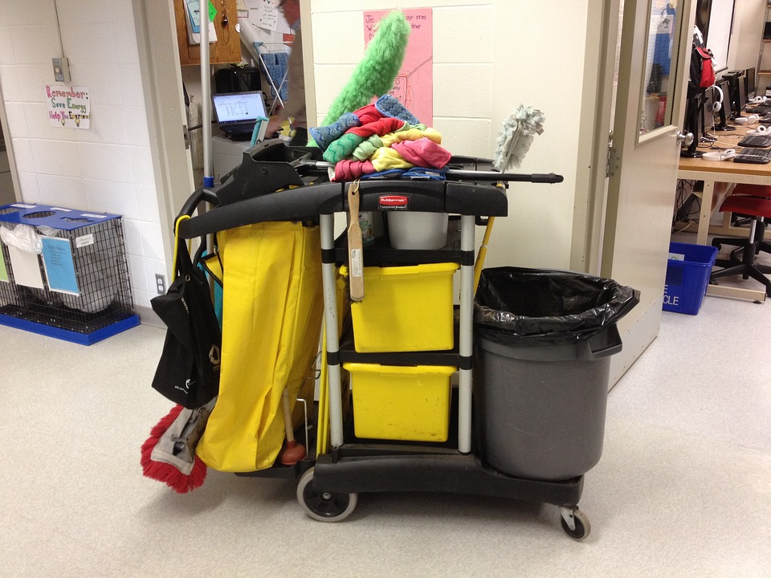
Housekeeping

Slide 55
Homework
Before the next lab, you should complete PaintPot (parts 1 and 2), and the game "Mole Mash": http://appinventor.mit.edu/explore/ai2/molemash-2.html

Slide 56

Lab 2
You will create a game.
User can hit the baddie but not the goodie
Further instructions in VISION
Individual task, part of lab assessment (5%)
Doing the homework (mole mash) first will help!

Slide 57
Peer Marking
3 people must mark your app!
Instructions on vision
This MUST be done in the lab

Slide 58
Today we cover
Procedures
Screens
External non-visible components
Run time errors
Coursework App 1

Slide 59
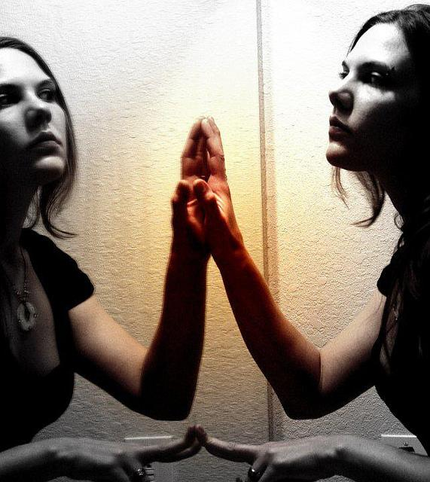
Learning Logs
You should reflect on what you have learnt in the last week and in this lab. You should summarise the feedback that you received from the peer marking, and reflect upon what you will do as a result of that feedback
https://www.flickr.com/photos/tifpics/

